Slide 1
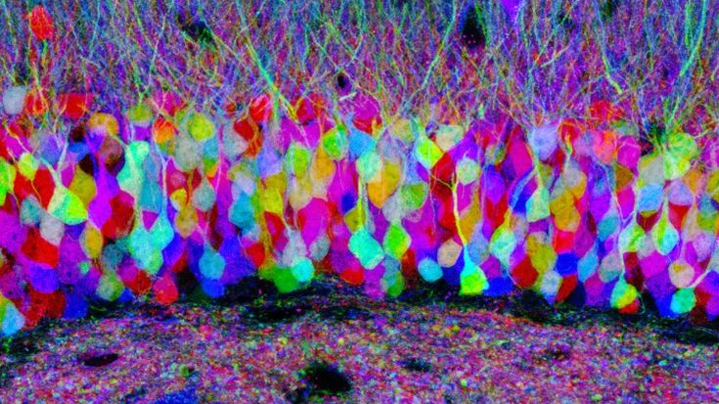
Track module 1 Basics of Image Processing and ML in Python Block 3
Ekaterina Golubeva
17.10.2022

Slide 2
Menu for today
Filters (edge detectors, entropy) and thresholding in skimage
Denoising with Gaussian, median, non-local means filters
Histogram based segmentation in skimage
Resizing images, splitting and merging channels in OpenCV
Denoising and Edge detection in OpenCV
CLAHE and Thresholding in OpenCV
Skimage vs OpenCV image preprocessing

Slide 3
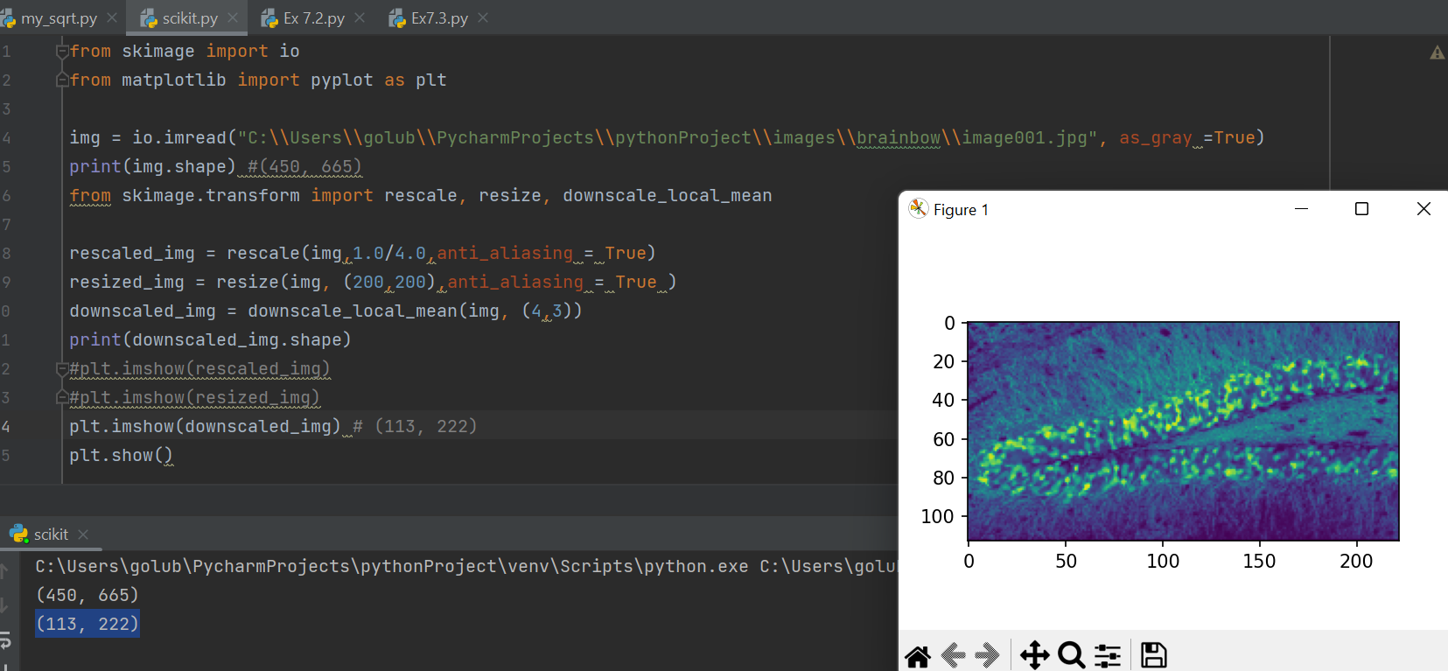
Scikit image : resize, rescale, downscale

Slide 4
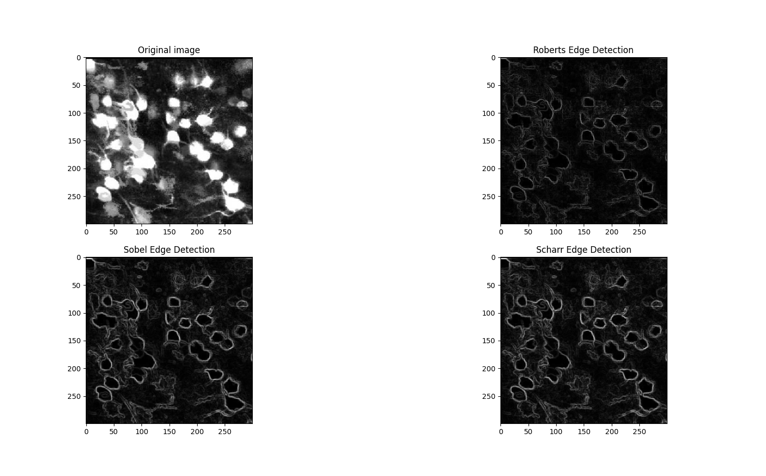
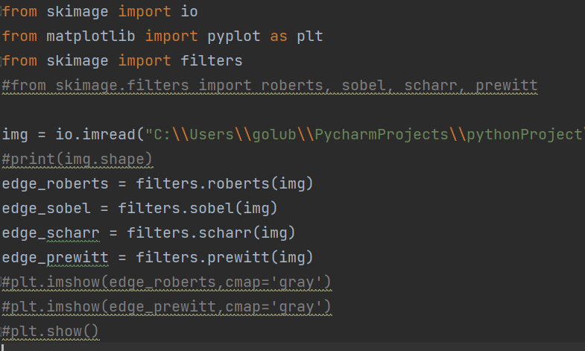
Edge detectors

Slide 5
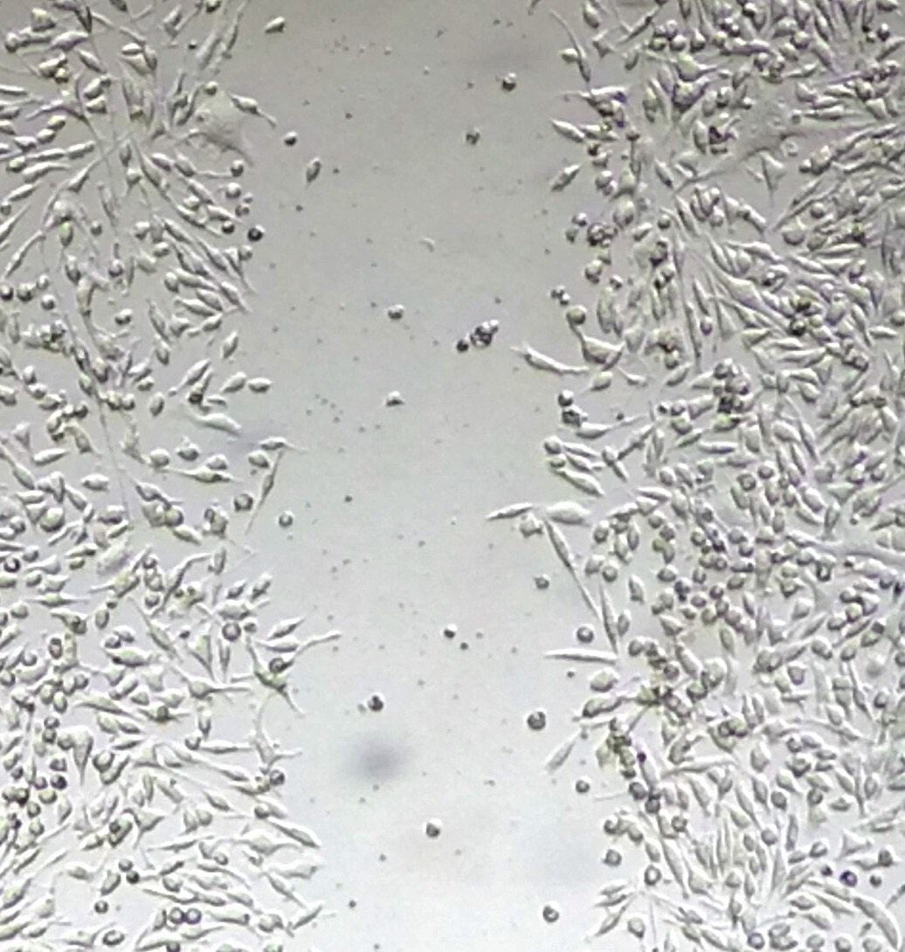
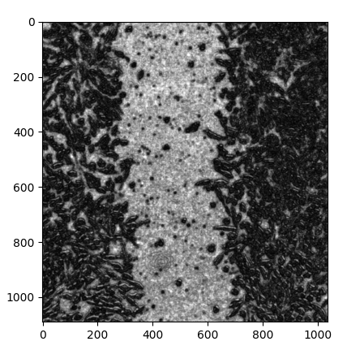
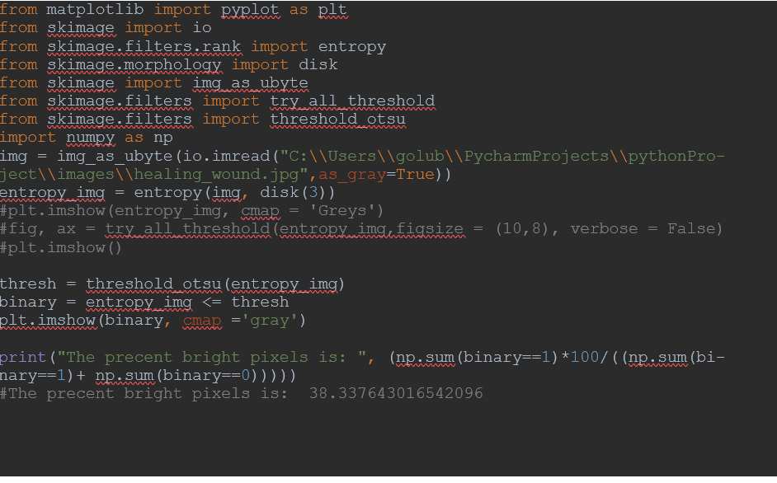
Entropy

Slide 6
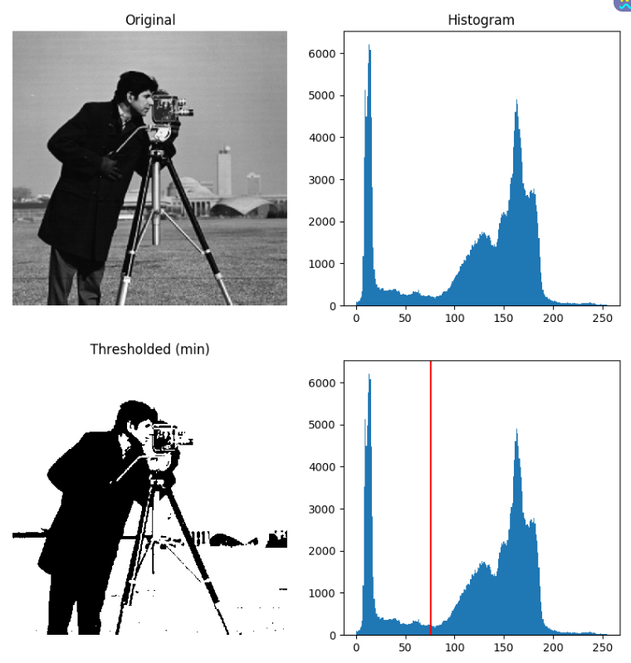
Thresholding
Thresholding is used to create a binary image from a grayscale image. It is the simplest way to segment objects from a background.
Thresholding algorithms implemented in scikit-image can be separated in different ways, one of them is histogram-based. The histogram of the pixels’ intensity is used and certain assumptions are made on the properties of this histogram.

Slide 7
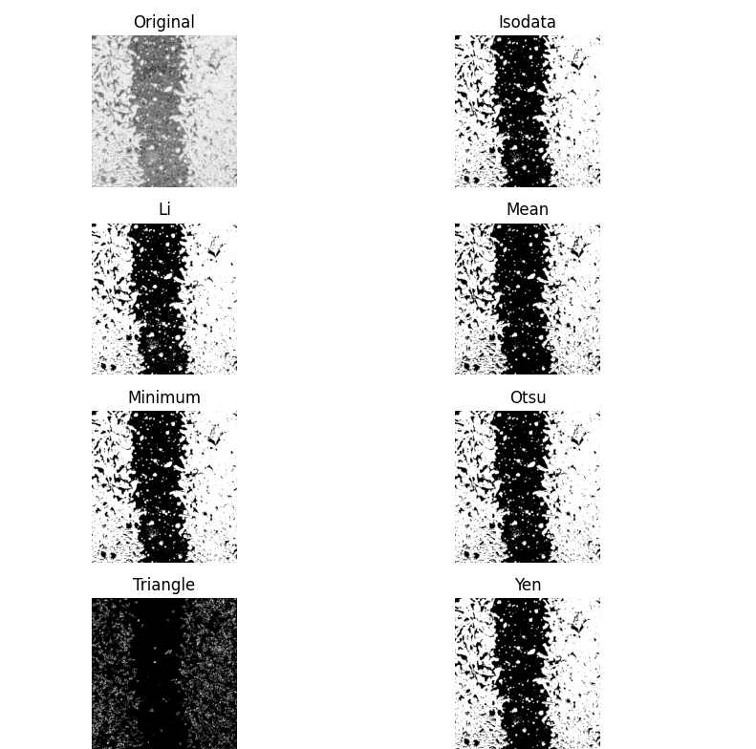
Trying different thresholding in skimage

Slide 8
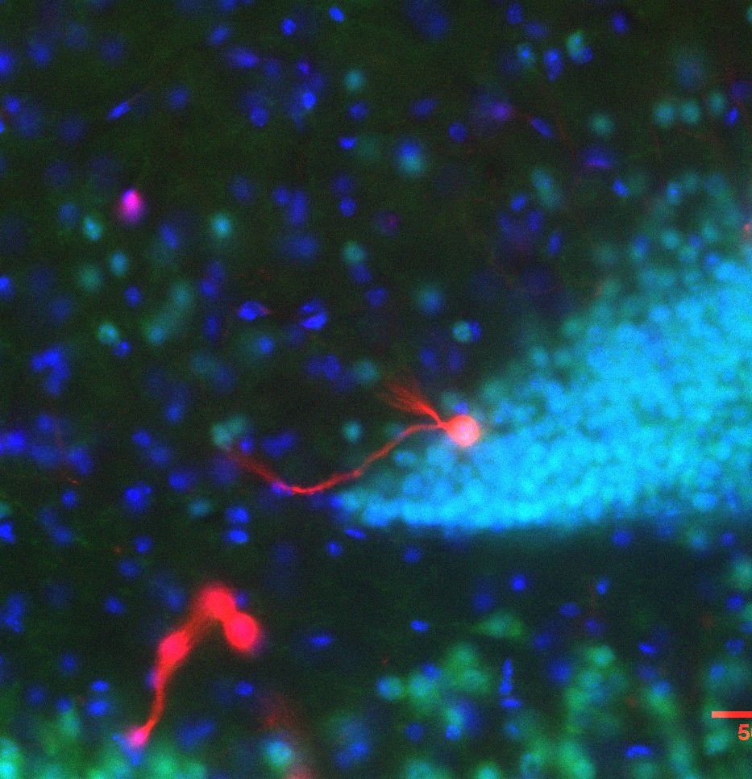
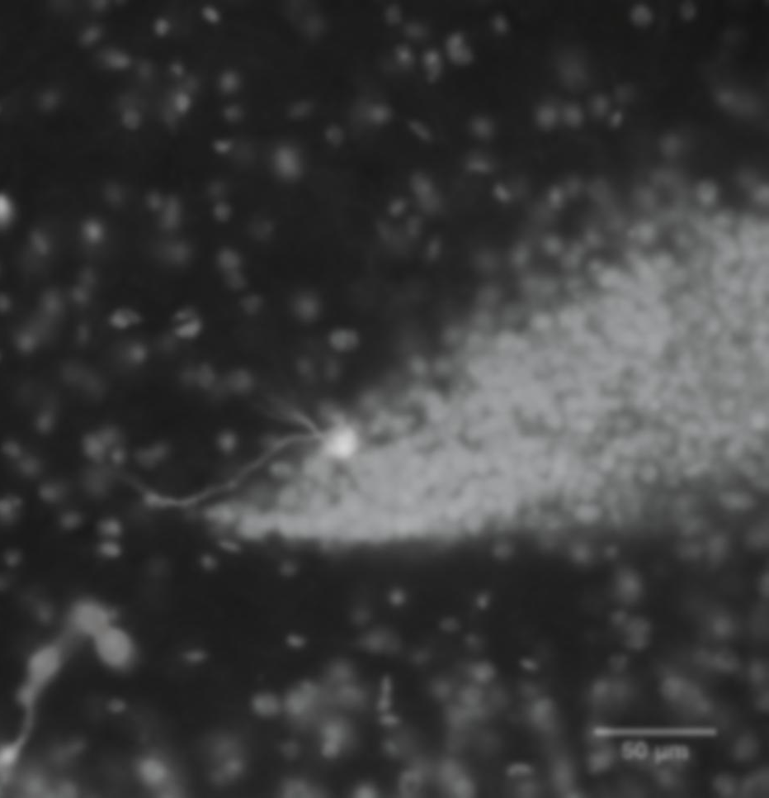
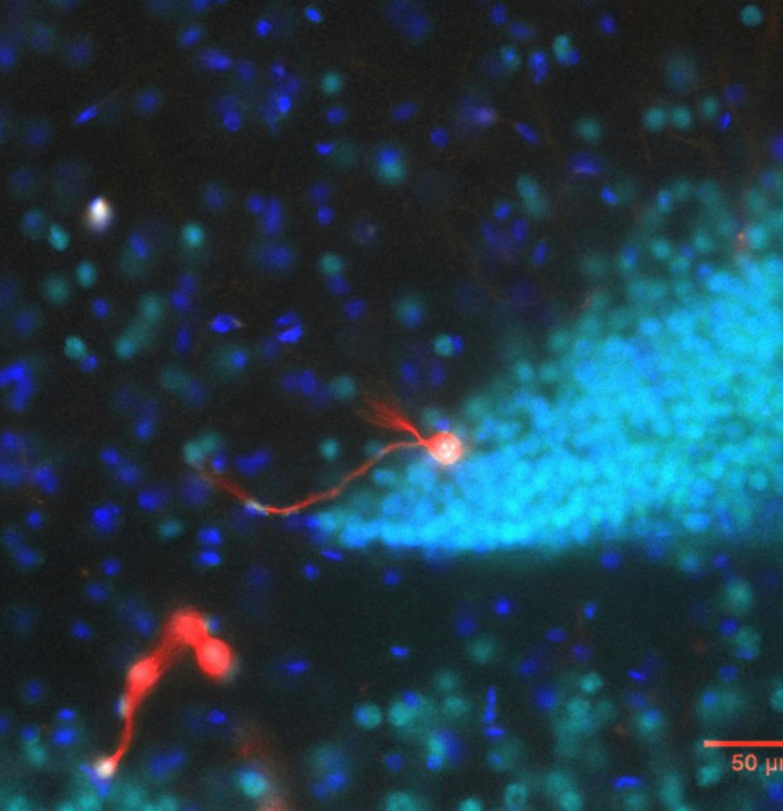
Denoising with Gaussian and median filters

Slide 9
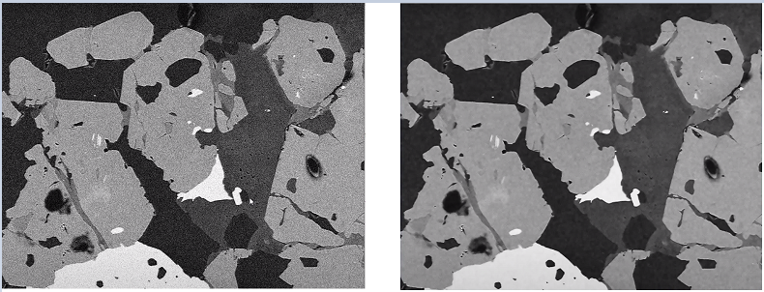
Non-local means denoising filter
Left side — noisy image; Right side — denoised image using NLM filter

Slide 10
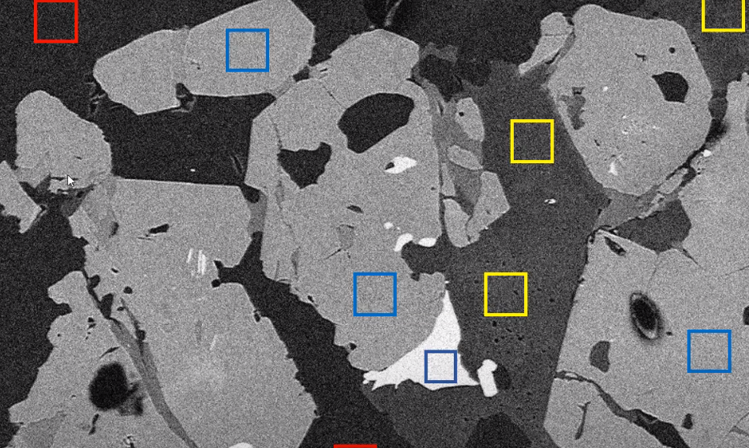
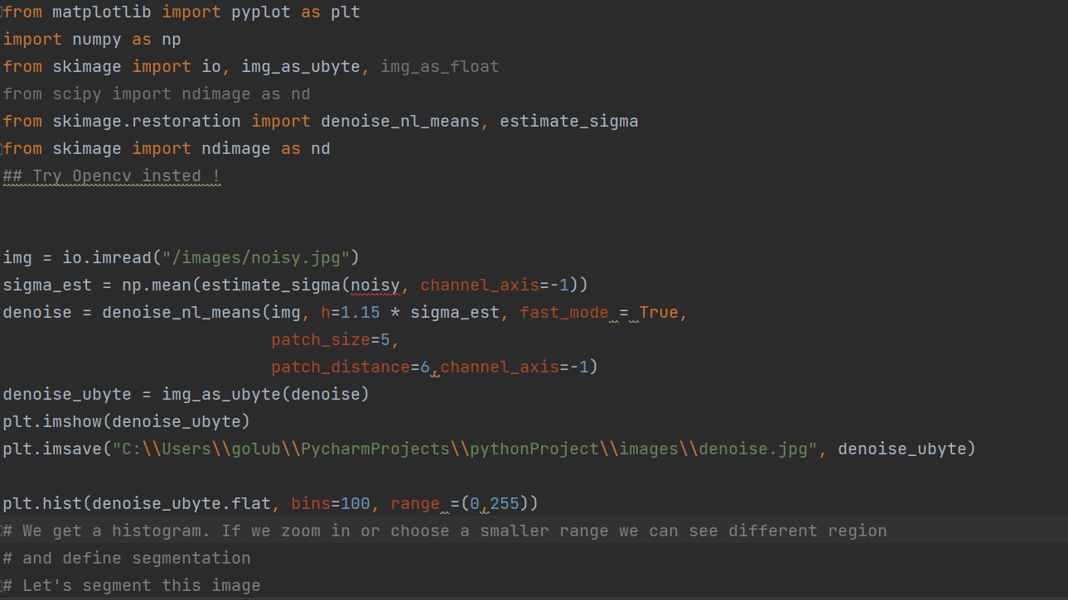
Histogram based segmentation

Slide 11
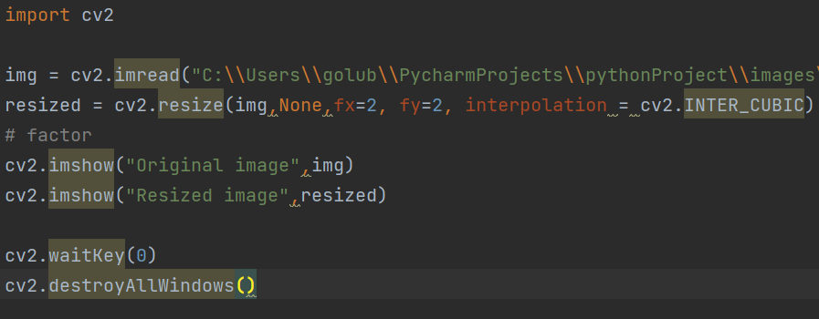
Resizing in OpenCV

Slide 12
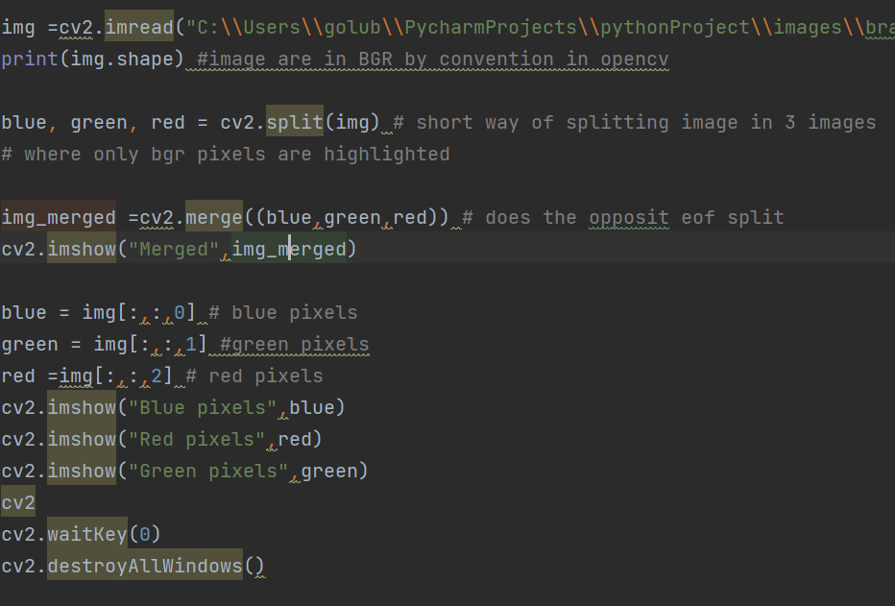
Splitting and merging channels in Open CV

Slide 13
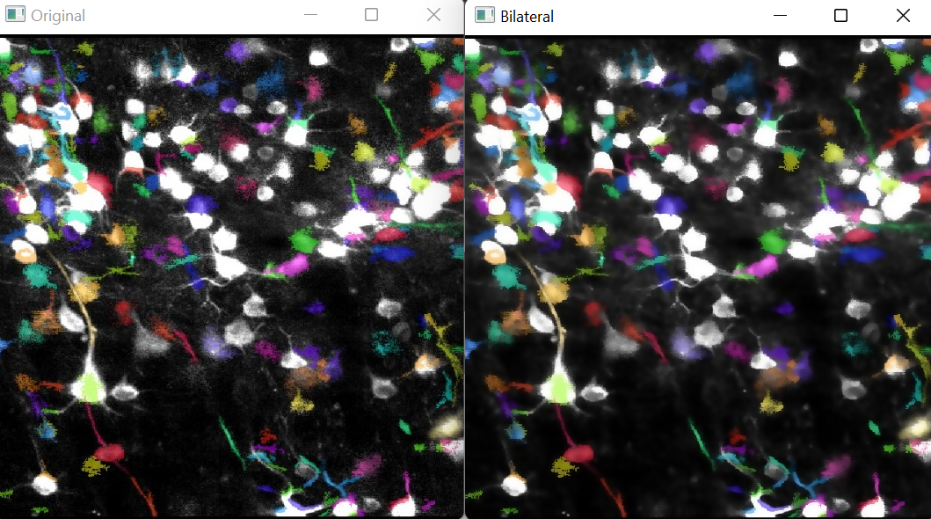
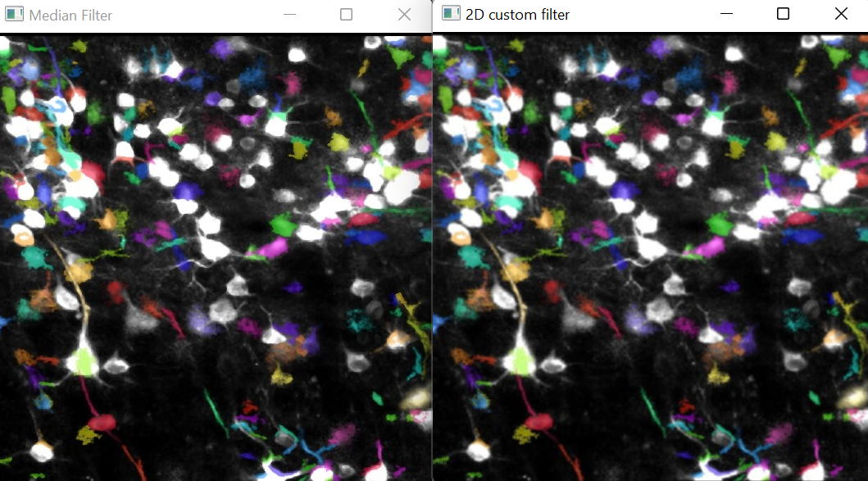
Denoising filters in OpenCV Gaussian blur, Median blur, Bilateral, 2D custom filter with kernel

Slide 14
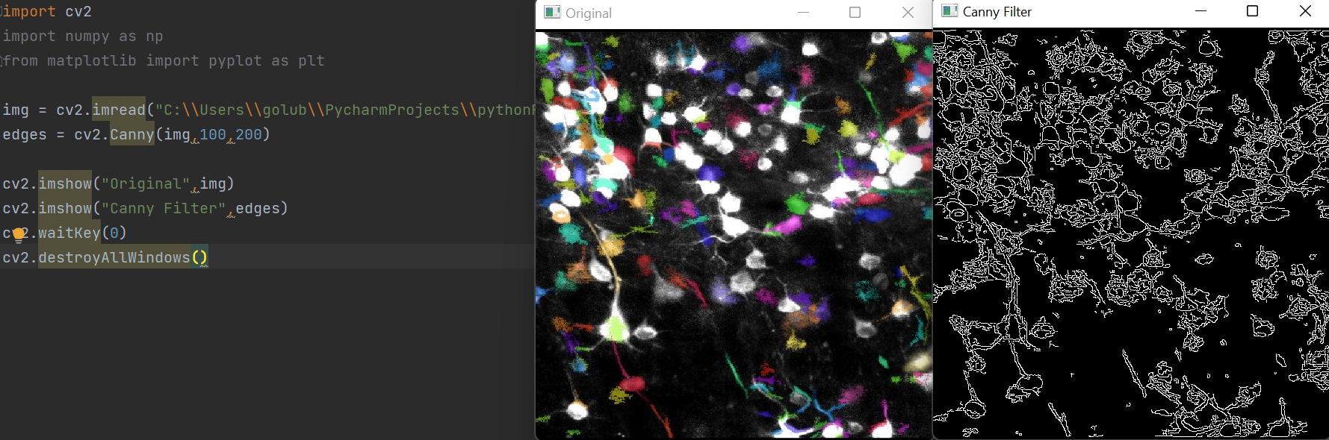
Edge detection with Canny in OpenCV

Slide 15
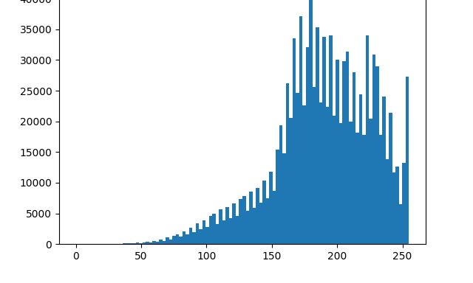
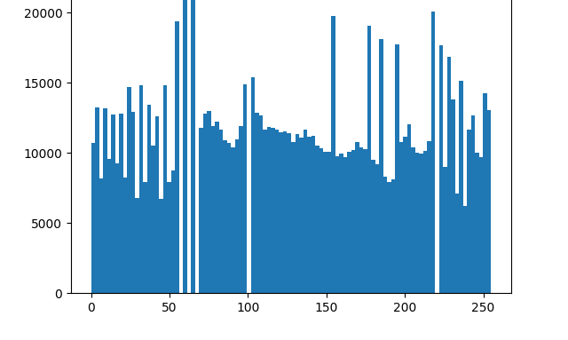
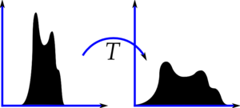
CLAHE using OpenCV
Contrast Limited Adaptive Histogram Equilization is used to preprocess images and make it easier to threshold them

Slide 16
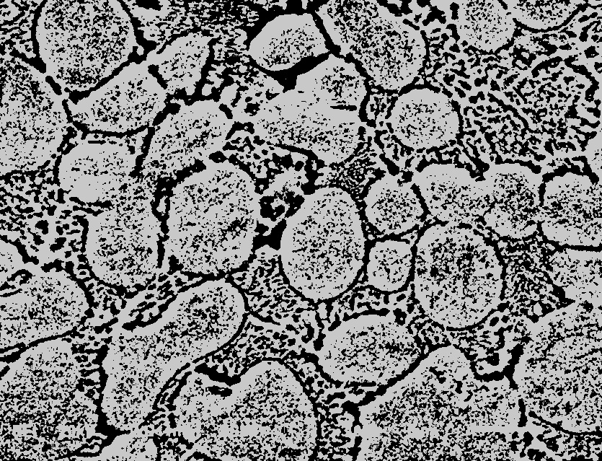
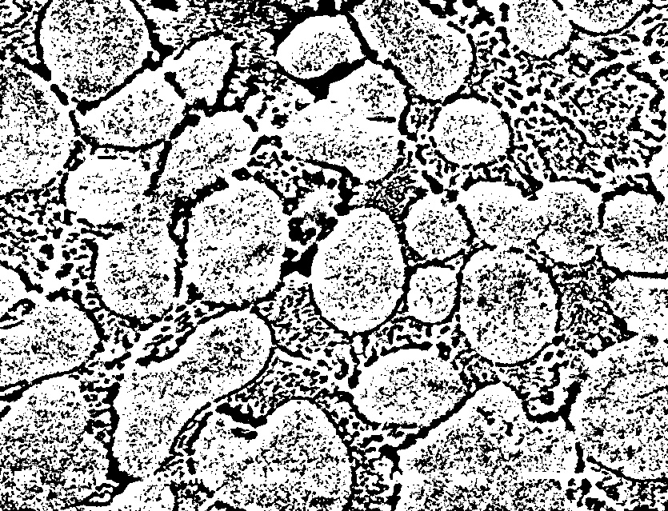
Thresholding using OpenCV
Studied thresholding techniques : Binary and Otsu
Remember to denoise first before thresholding !

Slide 17
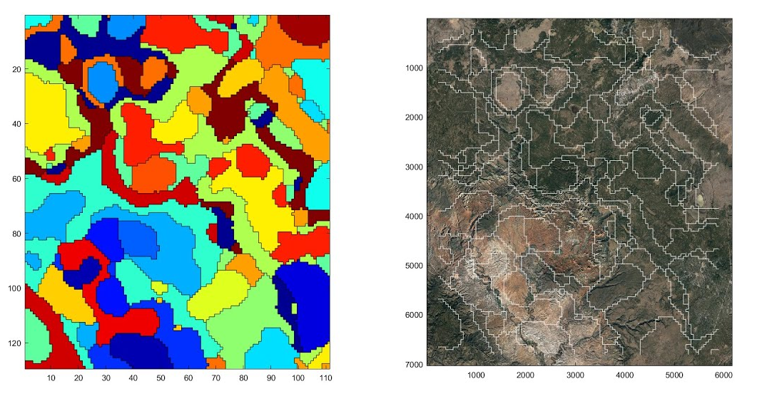
Goals for next week
Apply histogram-based segmentation to an example image (grey scaled) and colour the segments( fix skimage package or translate in OpenCV)
Try non-local means filter using OpenCV
Update the list of commands

